Slide 1


Mobile Phone Security
Dr. Digvijaysinh Rathod
Associate Professor
(Cyber Security and Digital Forensics)
National Forensic Sciences University with status of Institution of National Importance
digvijay.rathod@gfsu.edu.in

Slide 2
OWASP mobile top 10 security risks
OWASP mobile top 10 security risks
Dr. Digvijaysinh Rathod

Slide 3
OWASP mobile top 10 security risks
OWASP (Open Web Application Security Project) is an online community of security specialists that have created freely available
learning materials,
documentation and
tools to help build secure web and mobile applications.
Dr. Digvijaysinh Rathod

Slide 4
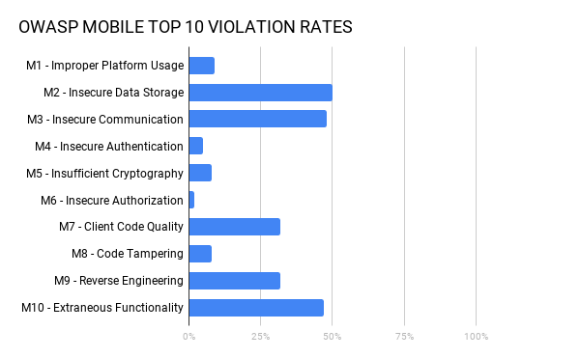
App vulnerabilities abound
https://www.nowsecure.com/blog/2018/07/11/a-decade-in-how-safe-are-your-ios-and-android-apps/
Dr. Digvijaysinh Rathod

Slide 5
OWASP mobile top 10 security risks
Even more alarming, 85% of mobile apps violate at least one or more of the Open Web Application Security Project (OWASP) Mobile Top 10 areas of risk, according to Now Secure’s benchmark testing.
Now Secure found more than half of tested apps have security flaws that compromise their ability to protect data in transit and at rest.
Nearly one-third of apps suffered from coding problems.
Dr. Digvijaysinh Rathod

Slide 6
OWASP mobile top 10 security risks
Android apps in particular exhibited coding issues that that could expose them to reverse engineering or other exploits.
Dr. Digvijaysinh Rathod

Slide 7
OWASP mobile top 10 security risks
M1 - Improper Platform Usage
M2 - Insecure Data Storage
M3 - Insecure Communication
M4 - Insecure Authentication
M5 - Insufficient Cryptography
M6 - Insecure Authorization
M7 - Client Code Quality
M8 - Code Tampering
M9 - Reverse Engineering
M10 - Extraneous Functionality
Dr. Digvijaysinh Rathod

Slide 8
M1 - Improper Platform Usage:
Improper Platform Usage covers mainly the misusing of platform features or failing to use platform security controls provided and documented by the platform and it’s community.
On Android-based applications, the AndroidManifest,xml file is certainly a well a information about the platform configuration and how the application should behave, this file is, indeed, a must-check for security miss-configurations.
Dr. Digvijaysinh Rathod

Slide 9
M1 - Improper Platform Usage:
Check AndroidManifest.xml for providers:
– identified by <provider> tag
– android:exported should be explicitly set to “false” if the content is
meant to be accessible only by the app itself, otherwise define proper
read/write permissions
Dr. Digvijaysinh Rathod

Slide 10
M1 - Improper Platform Usage:
Check AndroidManifest.xml for providers:
android:permission tags must be used to limit exposure to others
– android:protectionLevel should be set to “signature” (content
accessible only by apps signed with the same key)
Ref: https://owasp.org/www-pdf-archive/GiuseppePorcu-OWASPItalyDay19-10-2018.pdf
Dr. Digvijaysinh Rathod

Slide 11
M1 - Improper Platform Usage:
Check source code for:
android.content.ContentProvider, android.database.Cursor,
android.database.sqlite, .query, .update, .delete
Dr. Digvijaysinh Rathod

Slide 12
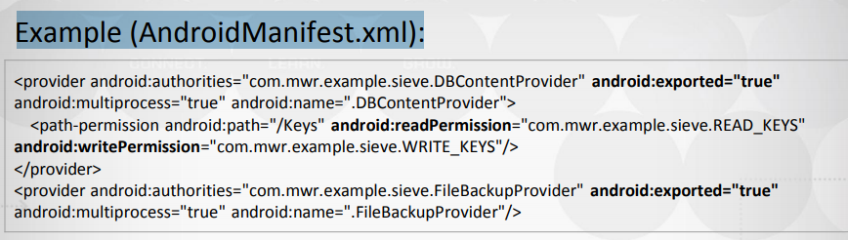
M1 - Improper Platform Usage:
Example (AndroidManifest.xml):
Some automatic tools can be used to inspect the app and identify content provider URIs, for example Drozer with scanner.provider.finduris module
Dr. Digvijaysinh Rathod

Slide 13
Mobile Phone Security
Dr. Digvijaysinh Rathod
Associate Professor
(Cyber Security and Digital Forensics)
Institute of Forensic Science
Gujarat Forensic Sciences University
digvijay.rathod@gfsu.edu.in

